Slide 1




Webinar Series 2016
Religious literacy
The importance of supporting religious literacy skills amongst your pupils
4.00pm - 4.45pm
Tuesday 26th January 2016
http://www.interfaithexplorers.com/webinars

Slide 2
www.interfaithexplorers.com
Supported by UNESCO
Helps pupils understand the world around them & respect cultural and religious diversity
Offers high quality cross-curricula resources to use with pupils at Key Stage 2 and those embarking on their Key Stage 3 transition
Supports core personal and social skills development as well as self-directed, exploratory learning
Promotes universal core values & the development of ethical thinking
Designed to compliment RE and PSHE teaching, alongside citizenship education

Slide 3
Webinars
Support teachers in their work around interfaith dialogue and RE; as well as PSHE and Citizenship learning in schools
Offers a space for teachers to come together and think about issues arising from classroom practice in these areas

Slide 4
Webinar Presenter
Claire Clinton
  An experienced teacher within EYFS, Primary and Secondary education
  She has over 20 years of classroom experience, and 16 years of advisory work at a national and local level
  For the past 10 years has been the Religious Education Advisor for the London Borough of Newham

Slide 5
Session objectives
To show how RE can help support the development of religious literacy in schools;
To understand:
  What strategies are effective;
  Key principles for running sensitive discussions in the classroom;
  Approaches to religious literacy learning that equip pupils with the skills to conceive, discuss and engage with religious subjects that they are being taught;
  Why religious literacy should also be viewed as a set of skills supporting an attitude of humility, respect and curiosity;
Offer practical activities that teachers can use in the classroom.

Slide 6
What is religious literacy?
Religious literacy is the knowledge of, and ability to, understand religion
In the British context: more people profess a post-Christian spirituality, humanism or atheism belief & other faith communities have become prominent
The Commission on Religion and Belief in Public Life on religious literacy:
‘the potential for misunderstanding, stereotyping and oversimplification based on ignorance is huge – and schools have a big part to play in putting this right’

Slide 7
Why is it important?
Harvard Religious Literacy Project states:
‘Understanding these complex religious influences is a critical dimension of understanding modern human affairs. In spite of this awareness, there remains a widespread illiteracy about religion that spans the globe. There are many consequences of this illiteracy, but the most urgent is that it fuels conflict and antagonisms and hinders cooperative endeavours in all arenas of human experience’

Slide 8
Prof. Adam Dinham, Goldsmiths College
‘There is a lamentable quality of conversation about religion and belief, just as we need it most. Billions of people around the world remain religious, despite the assumptions of secularity. Millions are in Britain, Europe and the West.
Globalization and migration put us all in to daily encounter with increasing diversity and plurality in our professional and everyday lives.
After decades in which we have barely talked about religion and belief in public discourses and practices, society has largely lost the ability to do so. Diversity, global trade, equality frameworks, and extremism make it pressing to do so now.’

Slide 9
As educators…
One can not judge a whole group by the evils committed by a few;
So in light of extremism concerns:
  We cannot judge 1.6 billion Muslims in the world, for the wrongful action of Daesh (who inappropriately call themselves the ‘Islamic State’)
  Just like it would be wrong to condemn a whole faith group for the actions of the Nazi's or the Ku Klux Klan.
  British Muslim parents are very concerned about the negative messages constantly being bombarded from the media, and its effects on children's sense of identity and safety.

Slide 10
Developing Religious Literacy
We need to talk about religious & world views in all relevant areas of our curriculum;
Enables teachers to improve their subject knowledge and confidence to talk about religious matters;
Helps teachers overcome fears about classroom discussions; and think about controversial or difficult situations / topics

Slide 11
Religious Literacy Strategies (1)
Ensure you follow your agreed syllabus or units of study for RE with your class:
  These have been thought out so that over the course of a pupils life at your school they will receive a broad education into religions!
Steer away from being simplistic about religions and beliefs:
  There are agreed central beliefs but a lot of difference in terms of interpretation and practice in all belief systems

Slide 12
Religious Literacy Strategies (2)
Encourage debate
Develop active listening skills
Be reflective: think and engage with discussions
Explain when your view has changed
Use facts and situations to develop pupils thinking around diversity and being to identify it

Slide 13
Handling sensitive discussions (1)
Ensure your pupils:
  Know your ground rules for classroom discussions:
    How do pupils ask a question?
    Disagree with someone?
    Talk to class or peers?
  Use ‘ownership’ language: e.g. ‘in my opinion’, ‘some Hindu’s…’
  Are encouraged to explore the issue, look for facts and think about where to look for answers

Slide 14
Handling sensitive discussions (2)
Teachers should:
  Affirm contributions from everyone, even if you don’t agree with it
  It gives you something to help them learn from
  Allow for a range of answers
  Correct wrong factual information
  Ensure the information you give is balanced

Slide 15
Handling sensitive discussions (3)
Throw back questions for further clarification with phrases like:
  What do you think?
  Can you clarify this for us?
You want to keep pupils pondering
Be honest with pupils, without being ruthless
Give time for quiet reflection, or reflective writing, to allow pupils time to assimilate information

Slide 16
Handling sensitive discussions (4)
Use resources and activities available on www.interfaithexplorers.com:
  Taster activities: Lemon activity – good way into interfaith discussions
  Teachers guidance: Advice on website on dealing with difficult issues, how to run an enquiry with respect & making choices

Slide 17
Practical activities
Avoid questions that result in recall or comprehension answers
Ask questions that demand analysis, application, evaluation and synthesis;
Deploy games that build up confidence in using religious terminology, e.g. ‘Don’t say that…’
Use classroom activities that develop thinking skills, e.g. ‘Same, similar and different’
See in appendix of PPT!

Slide 18
And finally…
‘Religious literacy helps you move from tolerance to respect’
Prof Adam Dinham
What teacher’s need to do differs depending on school and community context;
Regular conversations in our classrooms helps pupils build up their ability to discuss religion with respect and curiosity

Slide 19
Wrap up
Any questions?

Slide 20
Contact us
For further information about the webinar series and how Interfaith Explorers can support you visit:
www.interfaithexplorers.com
or contact
Rokhsana Fiaz OBE
Chief Executive
Maimonides Interfaith Foundation
rokhsana@maimonides-foundation.org

Slide 21
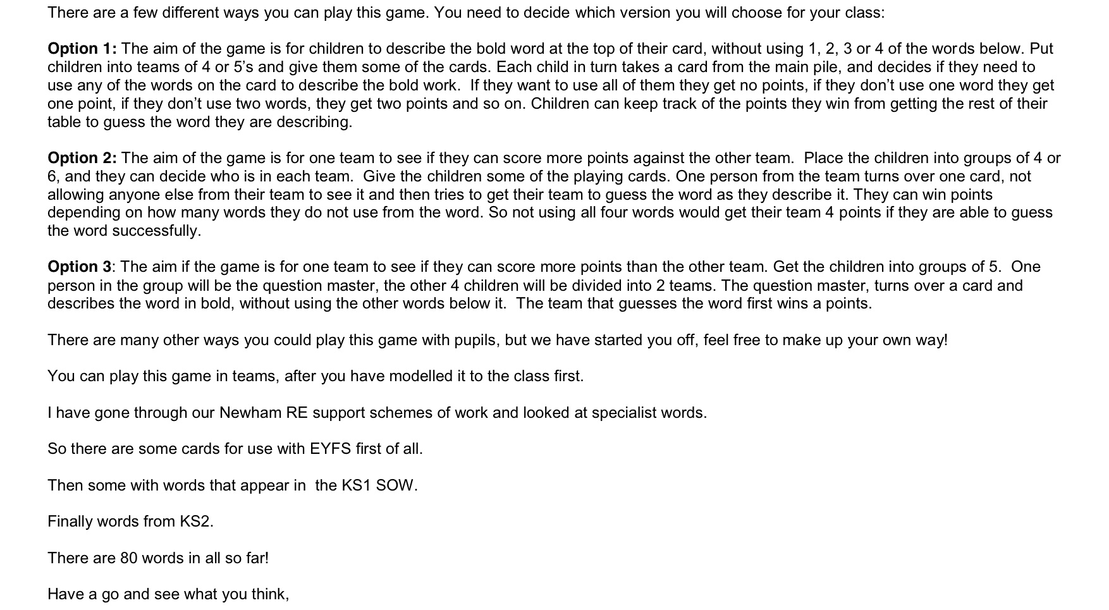
Game: Don’t Say It

Slide 22
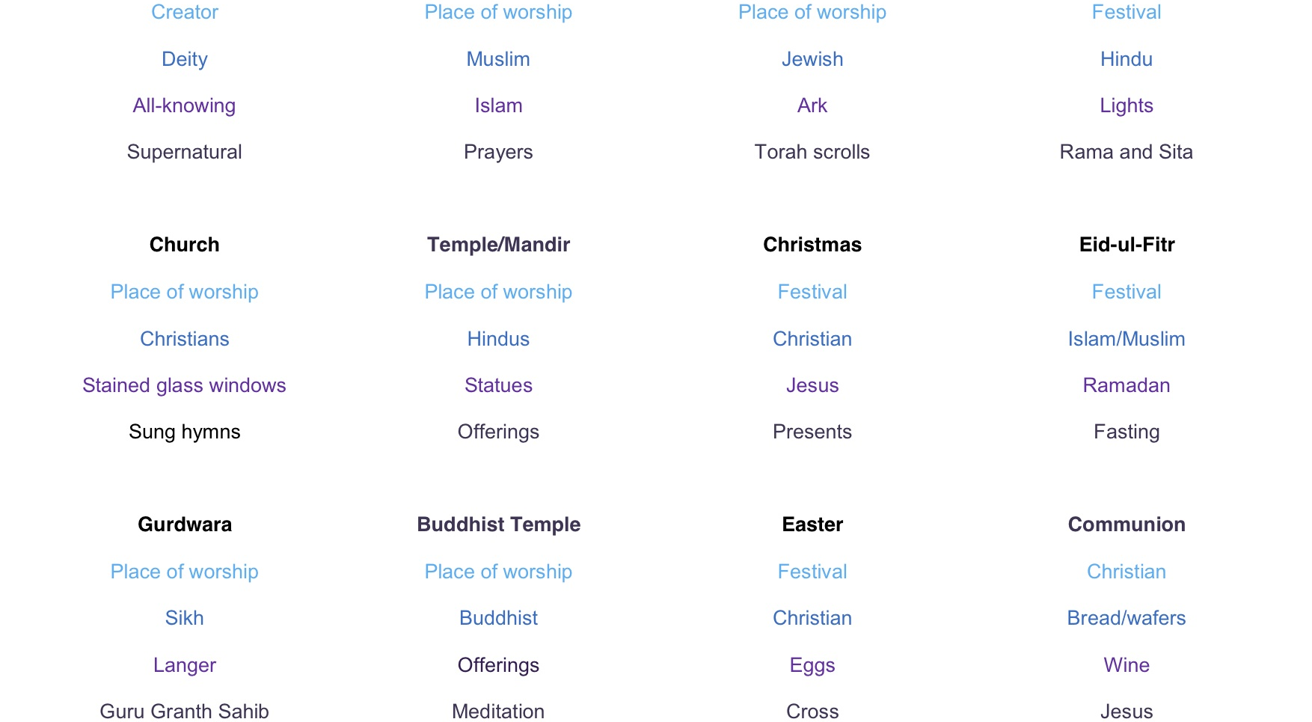
Game: Don’t Say It

Slide 23
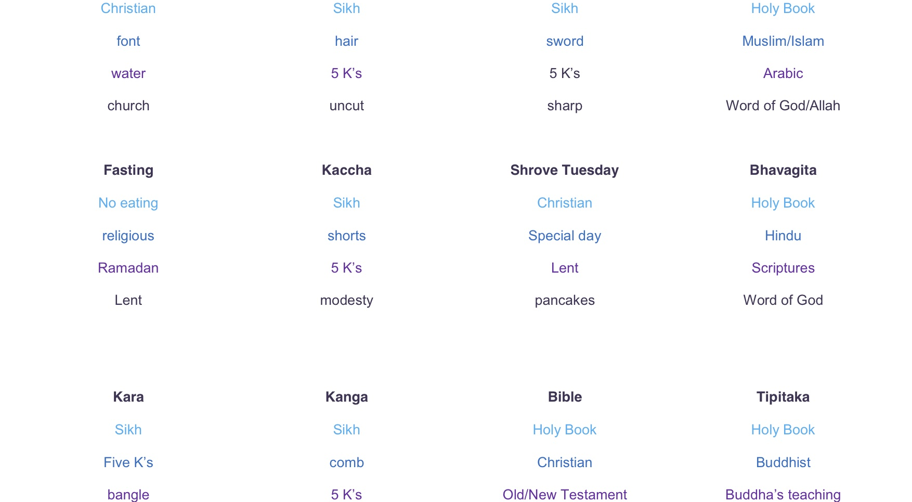
Game: Don’t Say It

Slide 24

Game: Don’t Say It

Slide 25
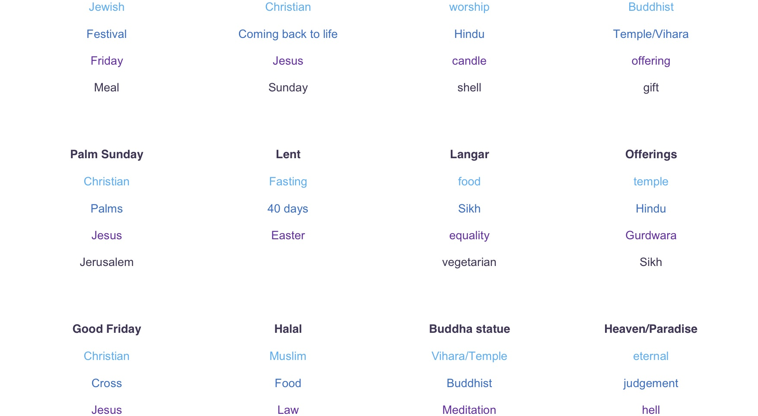
Game: Don’t Say It

Slide 26
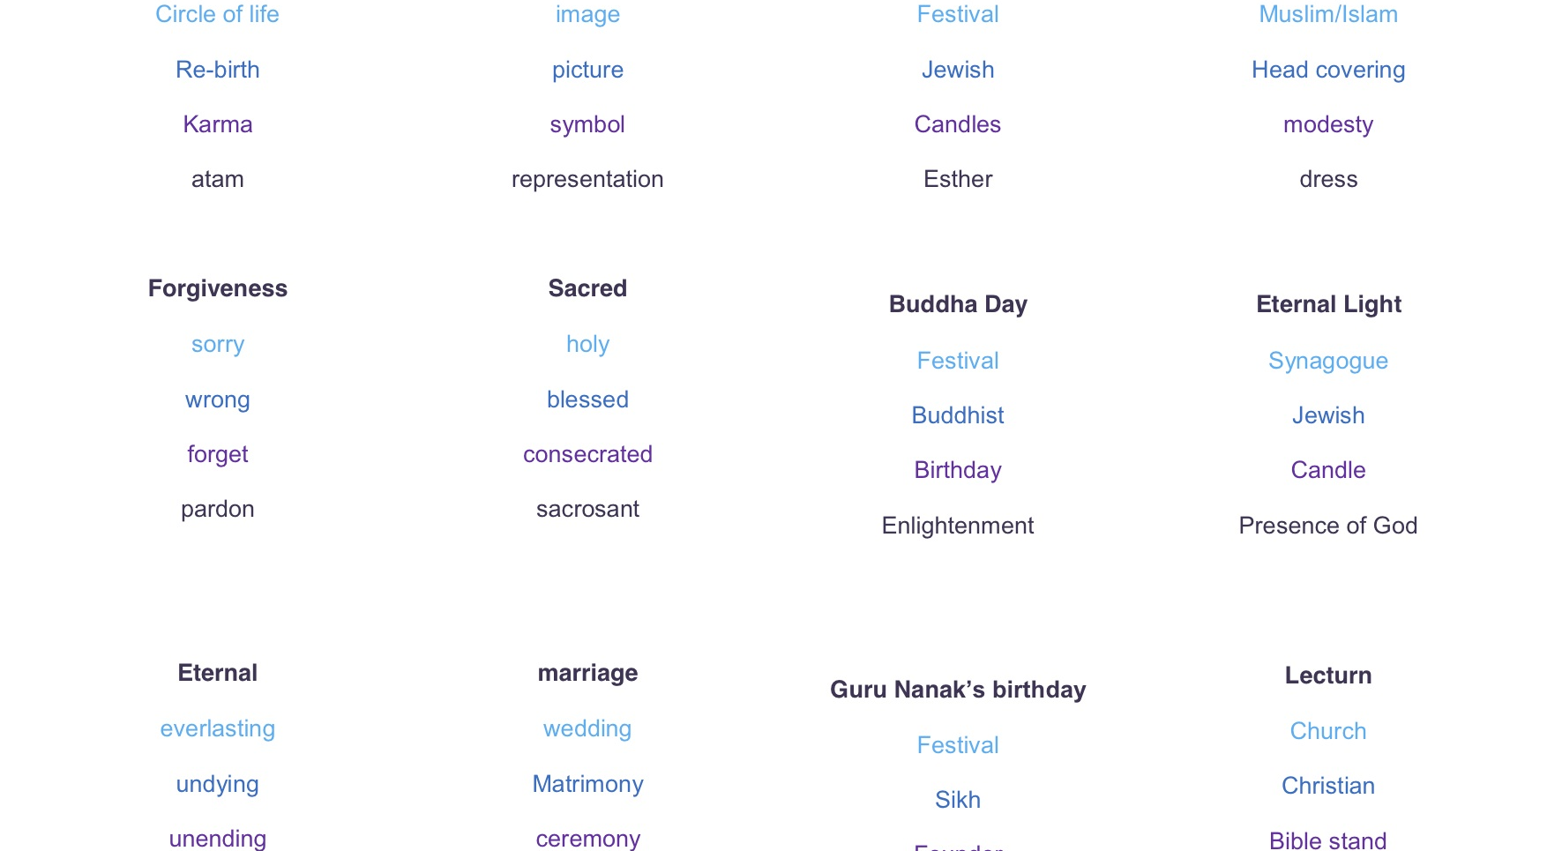
Game: Don’t Say It

Slide 27
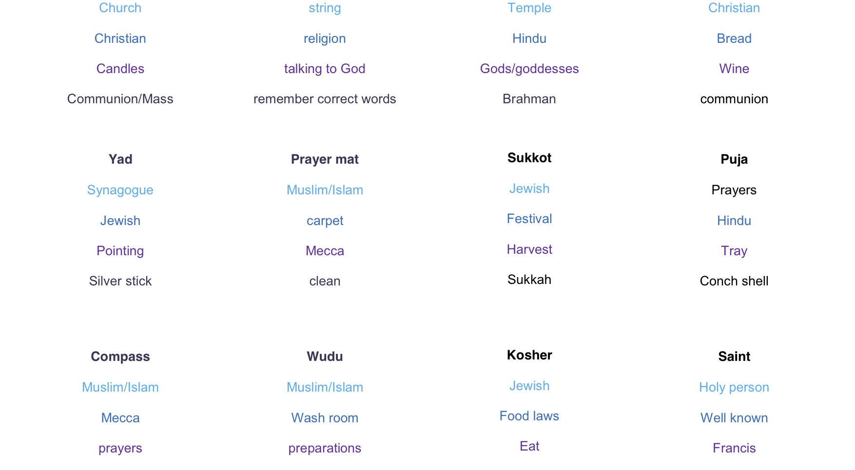
Game: Don’t Say It

Slide 28

Game: Don’t Say It

Slide 29
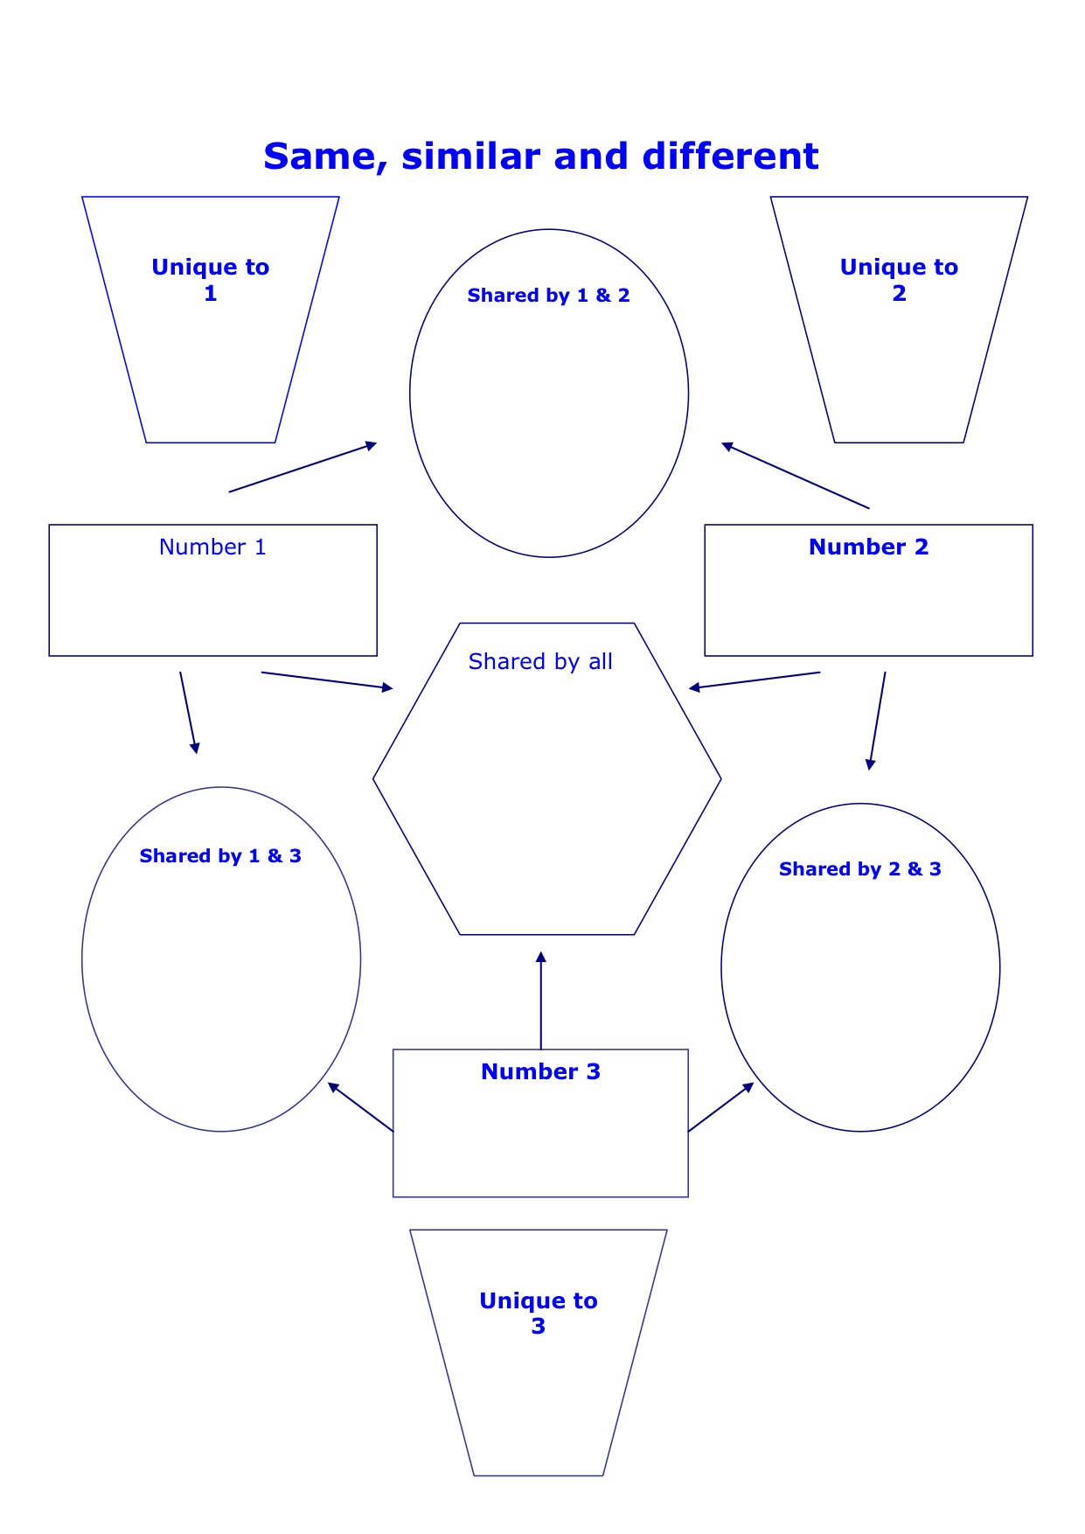
Classroom activity: Same, Similar, different

Slide 30
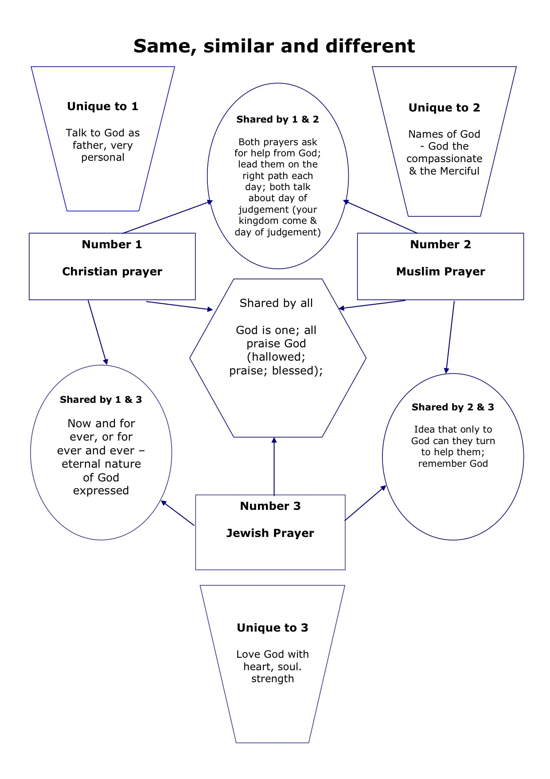
Classroom activity: Same, Similar, different

